Slide 1
Circuit Complexity
Erick Lin, Kurt Carpenter, William Hsu, Zach Justice

Slide 2
A Brief History
Shannon (1949) proves that a Boolean functions of n variables would require a circuit size of Θ(2^{n}/n)
Ajtai(1983) proves parity is not in the AC⁰ complexity class (Later Furst, Saxe and Sipser (1984))
Håstad (1987) proves any family of constant-depth circuits computing the parity function requires exponential size

Slide 3
Why is Circuit Complexity important?
Complexity of Finite Functions
Gives an idea of not only the time, but the problem size itself
Circuit Complexity Upper and Lower bounds can imply separate Complexity Classes
If the size of circuit complexity is different for hard questions, can be used as a further separating parameter
Circuit Complexity Lower bound imply universal derandomization
We can get a subexponential time simulation of randomized algorithm

Slide 4
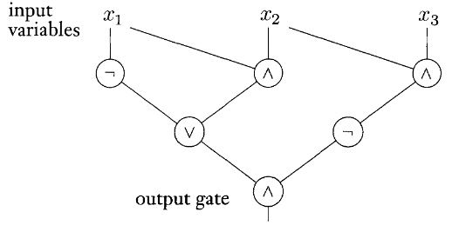
Useful Terms
Inputs: Boolean variables entering the circuit
Output: Single Boolean value output by the circuit
Gates: Fundamentally, Boolean AND/OR/NOT gates
Wires: Connections between inputs, gates, and outputs
Notes:
Image: Sipser's Introduction to the Theory of Computation 2nd edition - Figure 9.24

Slide 5

Circuit Families
Infinite list of circuits C such that C_{n} has n input variables
C decides language A if, given every string w with length n:
In essence, a circuit family returns true for every string in the decided language
Notes:
Image: Sipser's Introduction to the Theory of Computation 2nd edition - Figure 9.27

Slide 6
Circuit Size Complexity
Size: Number of gates in a Boolean circuit
Size Minimal: No equivalent circuit has a smaller size
Remember that multiple circuits can be equivalent
Size Complexity: Function for a circuit family that maps to the size of C_{n}
Circuit Complexity: Size complexity of a minimal circuit family for a given language
Circuit Complexity of a language related to its time complexity

Slide 7
Circuit Depth Complexity
Depth: Length of the longest path through the circuit, if the circuit is represented as a directed graph
Depth Minimal: No equivalent circuit has a smaller depth
Depth Complexity: Function for a circuit family that maps to the size of C_{n}

Slide 8
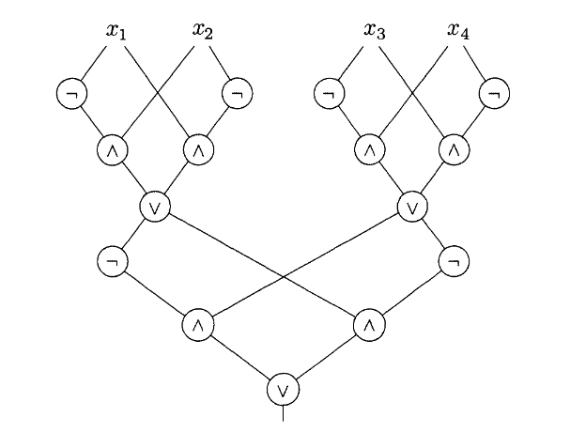

Example Circuit: parity₄
The parity function outputs 1 if there is an odd number of 1s in the input
parity_{n} takes in n input variables
parity₄
Size: 15
Depth: 6
Håstad's Switching Lemma proves exponential size

Slide 9
Circuit Complexity P/poly
P/poly = languages that can computed by polynomial-sized circuit
Can also be thought of as a language recognized by a polynomial-time Turing machine with a polynomial bounded advice function
In relation to the P=NP problem, if NP is not a subset of P/poly, then P ≠ NP

Slide 10
Circuit Complexity NC^{k}
For each nonnegative k, there is a class NC^{k} consisting of polynomial-size circuits of depth O(log^{k}(n)) with bounded fan-in AND, OR, and NOT gates]
The union of all these classes defines NC
Named after Nick Pippenger who did extensive research in this area
Can be thought of as the problems which can be efficiently solved on a parallel computer

Slide 11
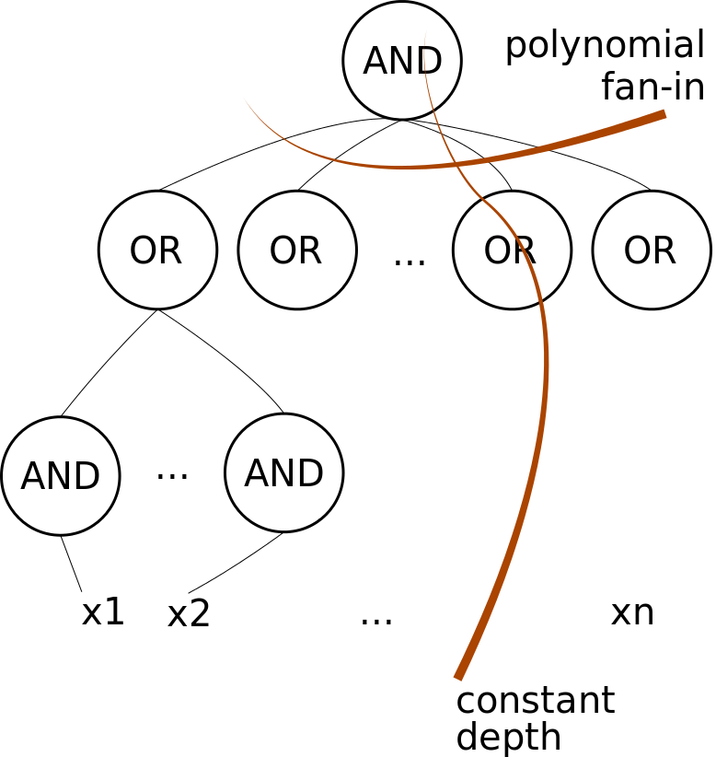
Circuit Complexity AC^{k}
AC = the union of AC^{k} for all nonnegative k, where AC^{k} = languages computed in constant depth, and polynomial size, unbounded fan-in
Relation between AC and NC:
Example AC⁰ circuit

Slide 12
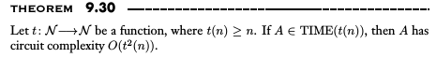
Simulating Turing Machines
Proof idea:
If M is a TM that decides A in time t(n), then for every n, we want to construct a circuit C_{n} that simulates M on inputs of length n. We do this by organizing the gates of C_{n} into rows, each corresponding to the configuration of M at one of the t(n) steps in M’s computation on an input of length n. Each row has a transition from the previous row. When M is about to accept, it moves its head to the leftmost tape cell to designate some gate in the last row of the circuit as the output gate.

Slide 13
Simulating Turing Machines
This theorem provides a method for proving P ≠ NP if you can show a language in NP has more than polynomial circuit complexity. Then using this theorem, we know that this language therefore has more than polynomial time complexity.
Notes:
Zach

Slide 14
Circuit SAT
The decision problems of determining whether a given Boolean circuit has a assignment that makes the output true
Can be proven to be NP-complete using Cook’s Theorem, and alternatively can be used to prove Cook’s Theorem
Current time complexity of Circuit SAT is O(2^{0.4058m}), where m is the number of binary gates
Notes:
Zach

Slide 15
Conclusion:
Computers use circuits and comparing complexity is objectively important.
Circuit complexity provides a method for proving P ≠ NP
Circuit complexity helps provide a bridge between Turing machines and the digital circuits used on our computers
Notes:
Zach

Slide 16
Questions?

